Slide 1
SRE
Lecture 10

Slide 2
Objectives
To describe the processes of requirements elicitation and analysis.
To introduce a number of requirements elicitation and requirements analysis techniques.
To discuss how prototypes may be used in the RE process.

Slide 3
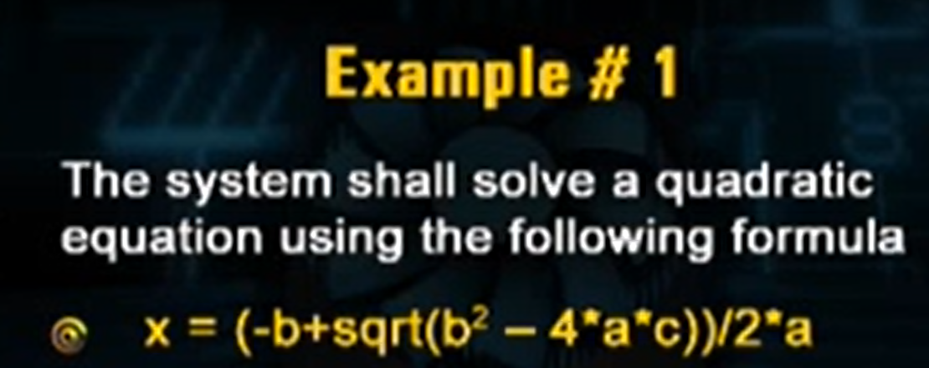

Slide 4
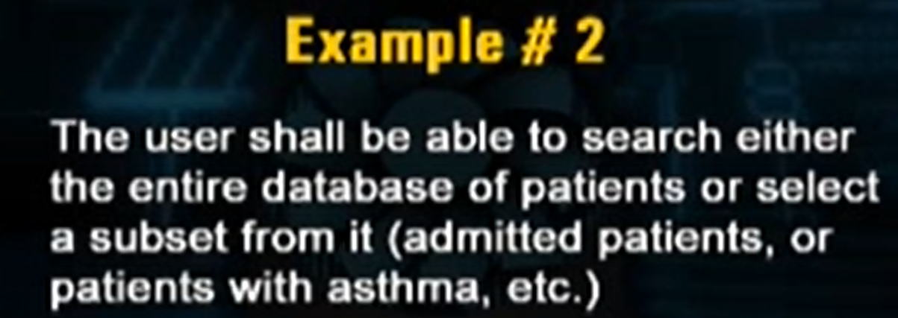

Slide 6
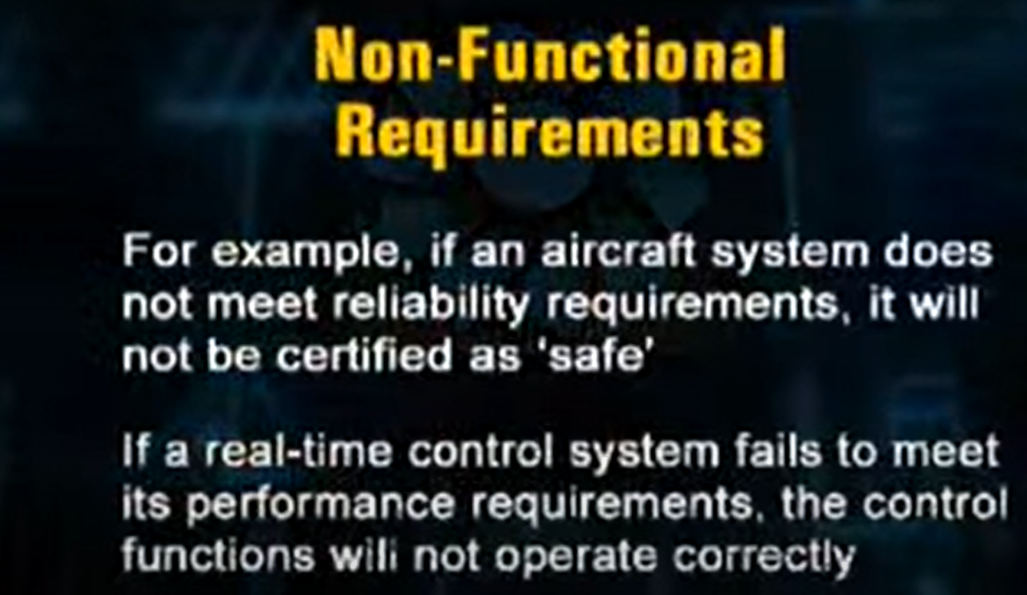

Slide 7
Components of requirements elicitation

Slide 8
An example of a conflicting requirement might be that the Human Resources stakeholder group explicitly requests to capture the age of an employee, but the Data Privacy team is saying that the age of the employee may not be captured or used in reporting.

Slide 9
Elicitation activities
Application domain understanding
Application domain knowledge is knowledge of the general area where the system is applied.
Problem understanding
The details of the specific customer problem where the system will be applied must be understood.
Business understanding
You must understand how systems interact and contribute to overall business goals.
Understanding the needs and constraints of system stakeholders
You must understand, in detail, the specific needs of people who require system support in their work.

Slide 10
Elicitation, analysis and negotiation

Slide 11
The requirements elicitation process

Slide 12
Elicitation stages
Objective setting
The organizational objectives should be established including general goals of the business, an outline description of the problem to be solved, why the system is necessary and the constraints on the system.
Background knowledge acquisition
Background information about the system includes information about the organization where the system is to be installed, the application domain of the system and information about existing systems
Knowledge organization
The large amount of knowledge which has been collected in the previous stage must be organized and collated.
Stakeholder requirements collection
System stakeholders are consulted to discover their requirements.

Slide 13
Elicitation techniques
Specific techniques which may be used to collect knowledge about system requirements
This knowledge must be structured
Partitioning - aggregating related knowledge
Abstraction - recognizing generalities
Projection - organizing according to perspective
Elicitation problems
Not enough time for elicitation
Inadequate preparation by engineers
Stakeholders are unconvinced of the need for a new system

Slide 14
Specific elicitation techniques
Interviews (√)
Scenarios (√)
Soft systems methods
Observations and social analysis
Requirements reuse (√)

Slide 15
Interviews
The requirements engineer or analyst discusses the system with different stakeholders and builds up an understanding of their requirements.
Types of interview
Closed interviews. The requirements engineer looks for answers to a pre-defined set of questions
Open interviews There is no predefined agenda and the requirements engineer discusses, in an open-ended way, what stakeholders want from the system.

Slide 16
Interviewing essentials
Interviewers must be open-minded and should not approach the interview with pre-conceived notions about what is required
Stakeholders must be given a starting point for discussion. This can be a question, a requirements proposal or an existing system
Interviewers must be aware of organizational politics - many real requirements may not be discussed because of their political implications

Slide 17
Closed Ended Questions
How do customers place orders?
How many telephone orders are received per day?
What additional information would you like the new system to provide?
Do you find issues with the current system?
Open Ended Questions
What do you think about the current system?
What are some of the problems you face on a daily basis?
How satisfied or dissatisfied are you with the current process?

Slide 18
Discussion
Explain the problems which might arise if the following requirements were included in a requirements document for a library system:
The system shall provide an easy-to-use graphical interface based on MS Windows XP.
Accredited users should have privileged access to the cataloguing facilities of the system
The system software shall be implemented using separated modules for cataloguing, user access and archiving.
List possible stakeholders for a library cataloguing systems
Suggest how the following requirements might be rewritten in a quantitative way
The library system shall be easy-to-use.
The library system shall provide reliable service to all classes of users.
The library system shall provide a rapid response to all user requests for book information.

Slide 19
Interview Steps
Prepare
Conduct
Opening
Body
Closing
Follow through

Slide 20
Listening Steps
Hear
Interpret
Respond
Evaluate

Slide 21
Interviewing is typically individual activity
It is not considered a group activity
One very important group activity that is useful for data gathering and knowledge acquisition is Brainstorming

Slide 22
Exercises
Consider a stockholding system for a oil company which keeps track of the amount of petrol (gas) at each of its sales outlets and automatically reorders new stock when the tanks fall below a certain level
Identify possible stakeholders
List 5 questions you may want to ask when you are interviewing these stakeholders

Slide 23
Scenarios
Scenarios are stories which explain how a system might be used. They should include
a description of the system state before entering the scenario
the normal flow of events in the scenario
exceptions to the normal flow of events
information about concurrent activities
a description of the system state at the end of the scenario
Scenarios are examples of interaction sessions which describe how a user interacts with a system
Discovering scenarios exposes possible system interactions and reveals system facilities which may be required

Slide 24
Library scenario - document ordering
The user logs on to the EDDIS system
The order document command is issued
The reference number of the document which is required is entered on the order form
The user selects one of the delivery options from the delivery menu
The user logs out from EDDIS
This sequence of events can be illustrated in a diagram

Slide 25
Library Scenario

Slide 26
Assignment 3.a
Write plausible scenarios and use case for the following activities:
Registering for a university course
Processing an application for a credit card
Transfer funds from one account to another using an ATM

Slide 27
Scenarios and OOD
Scenarios are an inherent part of some object-oriented development methods
The term use-case (i.e. a specific case of system usage) is sometimes used to refer to a scenario
There are different views on the relationship between use-cases and scenarios:
A use-case is a scenario
A scenario is a collection of use-cases. Therefore, each exceptional interaction is represented as a separate use-case

Slide 28
Requirements reuse
Reuse involves taking the requirements which have been developed for one system and using them in a different system
Requirements reuse saves time and effort as reused requirements have already been analyzed and validated in other systems
Currently, requirements reuse is an informal process but more systematic reuse could lead to larger cost savings

Slide 29
Reuse possibilities
Where the requirement is concerned with providing application domain information.
Where the requirement is concerned with the style of information presentation. Reuse leads to a consistency of style across applications.
Where the requirement reflects company policies such as security policies.

Slide 30
Prototyping
A prototype is an initial version of a system which may be used for experimentation
Prototypes are valuable for requirements elicitation because users can experiment with the system and point out its strengths and weaknesses. They have something concrete to criticize
Rapid development of prototypes is essential so that they are available early in the elicitation process

Slide 31
Prototyping benefits
The prototype allows users to experiment and discover what they really need to support their work
Establishes feasibility and usefulness before high development costs are incurred
Essential for developing the ‘look and feel’ of a user interface
Can be used for system testing and the development of documentation
Forces a detailed study of the requirements which reveals inconsistencies and omissions

Slide 32
Types of prototyping
Throw-away prototyping
intended to help elicit and develop the system requirements.
The requirements which should be prototyped are those which cause most difficulties to customers and which are the hardest to understand. Requirements which are well-understood need not be implemented by the prototype.

Slide 33
Types of prototyping
Evolutionary prototyping
intended to deliver a workable system quickly to the customer.
Therefore, the requirements which should be supported by the initial versions of this prototype are those which are well-understood and which can deliver useful end-user functionality. It is only after extensive use that poorly understood requirements should be implemented.

Slide 34
Prototyping costs and problems
Training costs - prototype development may require the use of special purpose tools
Development costs - depend on the type of prototype being developed
Extended development schedules - developing a prototype may extend the schedule although the prototyping time may be recovered because rework is avoided
Incompleteness - it may not be possible to prototype critical system requirements

Slide 35
Analysis checks
Necessity checking
The need for the requirement is analyzed. In some cases, requirements may be proposed which don’t contribute to the business goals of the organization or to the specific problem to be addressed by the system.
Consistency and completeness checking
The requirements are cross-checked for consistency and completeness. Consistency means that no requirements should be contradictory; completeness means that no services or constraints which are needed have been missed out.
Feasibility checking
The requirements are checked to ensure that they are feasible in the context of the budget and schedule available for the system development.

Slide 36
Requirements analysis and negotiation

Slide 37
Requirements negotiation
Requirements discussion
Requirements which have been highlighted as problematical are discussed and the stakeholders involved present their views about the requirements.
Requirements prioritization
Disputed requirements are prioritized to identify critical requirements and to help the decision making process.
Requirements agreement
Solutions to the requirements problems are identified and a compromise set of requirements are agreed. Generally, this will involve making changes to some of the requirements.

Slide 38
Requirements analysis
The goal of analysis is to discover problems, incompleteness and inconsistencies in the elicited requirements. These are then fed back to the stakeholders to resolve them through the negotiation process
Analysis is interleaved with elicitation as problems are discovered when the requirements are elicited
A problem checklist may be used to support analysis. Each requirement may be assessed against the checklist

Slide 39
Analysis Techniques
Analysis Checklists
A checklist is a list of questions which analysts may use to assess each requirement
Interaction metrices
Interaction metrices are used to discover interactions between requirements to highlight conflicts and overlaps

Slide 40
Analysis checklists
Premature design
Does the requirement include premature design or implementation information?
Combined requirements
Does the description of a requirement describe a single requirement or could it be broken down into several different requirements?
Unnecessary requirements
Is the requirement ‘gold plating’? That is, is the requirement a cosmetic addition to the system which is not really necessary.

Slide 41
Analysis checklists
Use of non-standard hardware
Does the requirement mean that non-standard hardware or software must be used? To make this decision, you need to know the computer platform requirements.
Conformance with business goals
Is the requirement consistent with the business goals defined in the introduction to the requirements document? Requirements ambiguity
Requirements ambiguity
Is the requirement ambiguous i.e. could it be read in different ways by different people? What are the possible interpretations of the requirement?

Slide 42
Analysis checklists
Requirements realism
Is the requirement realistic given the technology which will be used to implement the system?
Requirements testability
Is the requirement testable, that is, is it stated in such a way that test engineers can derive a test which can show if the system meets that requirement?

Slide 43
REQ Interaction
Quality Parameter
Sort out Requirements
Sequence the requirements
Three types of Requirements:
Independent (0)
Conflict (1)
Overlap (100/1000)

Slide 44
Requirements interactions
A very important objective of requirements analysis is to discover the interactions between requirements and to highlight requirements conflicts and overlaps
A requirements interaction matrix shows how requirements interact with each other. Requirements are listed along the rows and columns of the matrix
For requirements which conflict, fill in a 1
For requirements which overlap, fill in a 1000
For requirements which are independent, fill in a 0

Slide 45
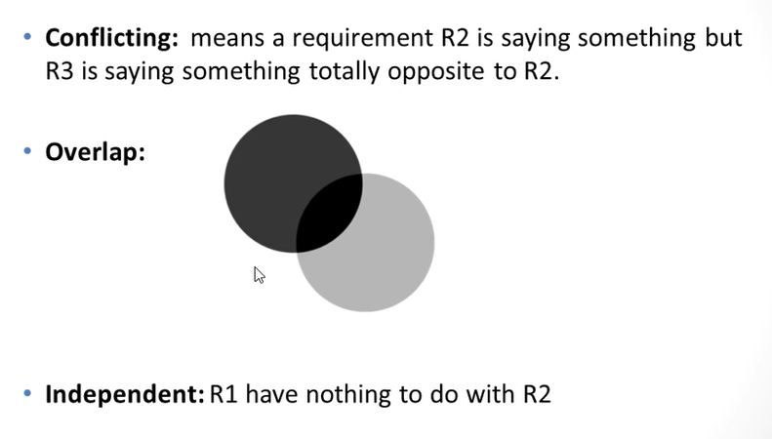

Slide 46
Problems that lead to requirements conflicts.
Voluminous requirements.
Changing requirements and analysts.
Complex requirements.
Conflicting stakeholder requirements.
Changing and unidentified stakeholders.
Changing expectations.

Slide 47
Interaction matrices

Slide 48
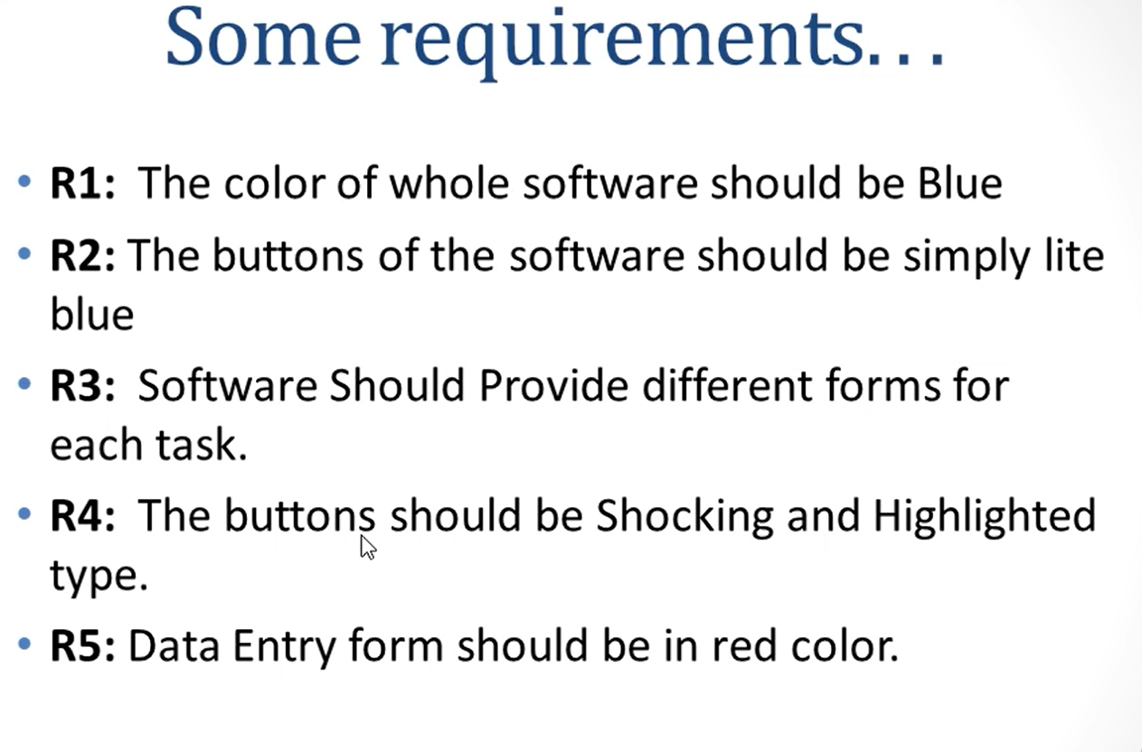
Example

Slide 49
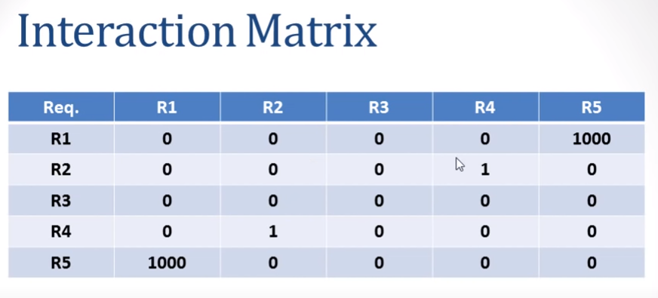

Slide 50
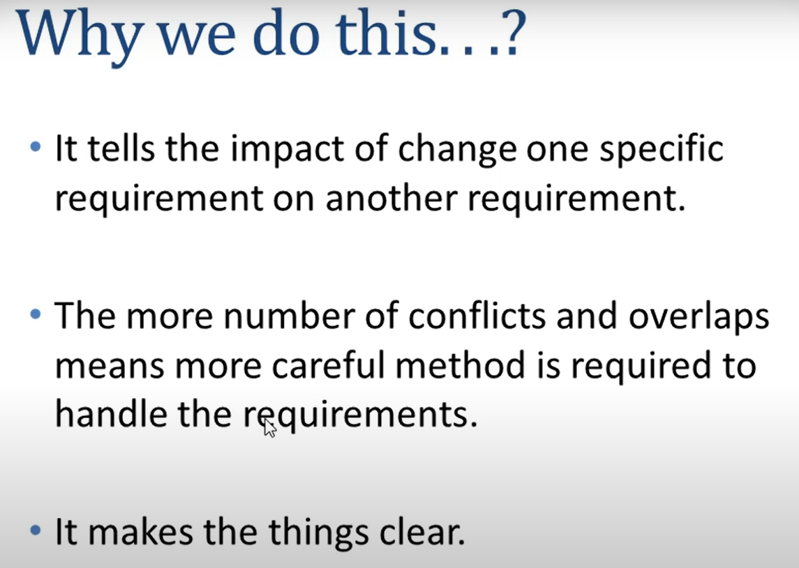

Slide 51
Requirements negotiation
Disagreements about requirements are inevitable when a system has many stakeholders. Conflicts are not ‘failures’ but reflect different stakeholder needs and priorities
Requirements negotiation is the process of discussing requirements conflicts and reaching a compromise that all stakeholders can agree to
In planning a requirements engineering process, it is important to leave enough time for negotiation. Finding an acceptable compromise can be time-consuming

Slide 52
Negotiation meetings
An information stage where the nature of the problems associated with a requirement is explained.
A discussion stage where the stakeholders involved discuss how these problems might be resolved.
All stakeholders with an interest in the requirement should be given the opportunity to comment. Priorities may be assigned to requirements at this stage.
A resolution stage where actions concerning the requirement are agreed.
These actions might be to delete the requirement, to suggest specific modifications to the requirement or to elicit further information about the requirement.

Slide 53
Chapter summary
Requirements elicitation involves understanding the application domain, the specific problem to be solved, the organizational needs and constraints and the specific facilities needed by system stakeholders.
The processes of requirements elicitation, analysis and negotiation are iterative, interleaved processes which must usually be repeated several times.
There are various techniques of requirements elicitation which may be used including interviewing, scenarios, soft systems methods, prototyping and participant observation.

Slide 54
Chapter summary
Prototypes are effective for requirements elicitation because stakeholders have something which they can experiment with to find their real requirements.
Checklists are particularly useful as a way of organizing the requirements validation process. They remind analysts what to look for when reading through the proposed requirements.
Requirements negotiation is always necessary to resolve requirements conflicts and remove requirements overlaps. Negotiation involves information interchange, discussion and resolution of disagreements.

